Slide 1
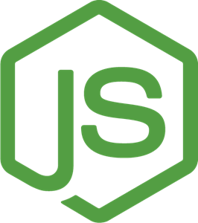
MVC Architecture
JavaScript Runtime
On Server Side

Slide 2
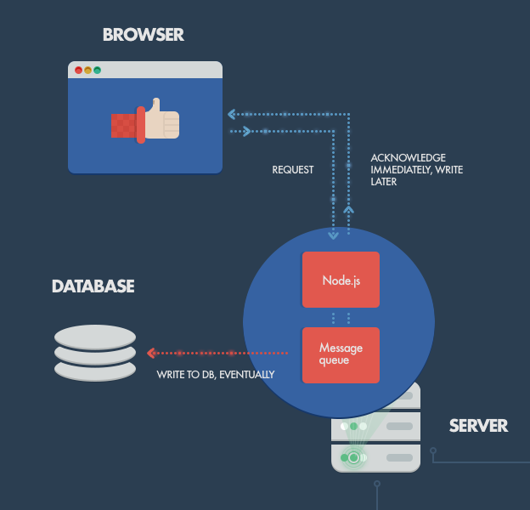
Application Architecture

Slide 3
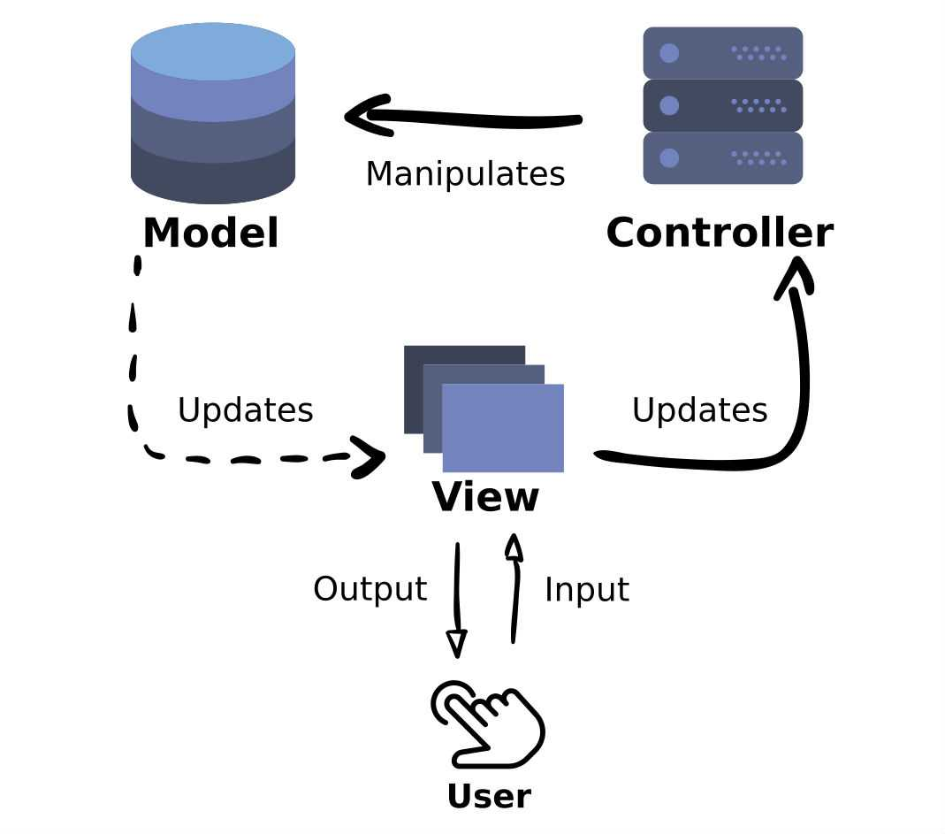
MVC Introdcution
MVC là mẫu thiết kế về kiến trúc phần mềm để cài đặt giao diện người dùng (User Interfaces)
Model: Represents the data and does nothing else. The model does not depend on the controller or the view.
View: Displays the model data, and sends user input to the controller.

Slide 4
MVC Introdcution
The view can be:
independent of both the model and the controller.
Or actually be the controller and therefore depend on the model.
Controller: Provides model data to the view. The controller depends on both the view and the model and, in some cases, the controller and the view are one in the same

Slide 5
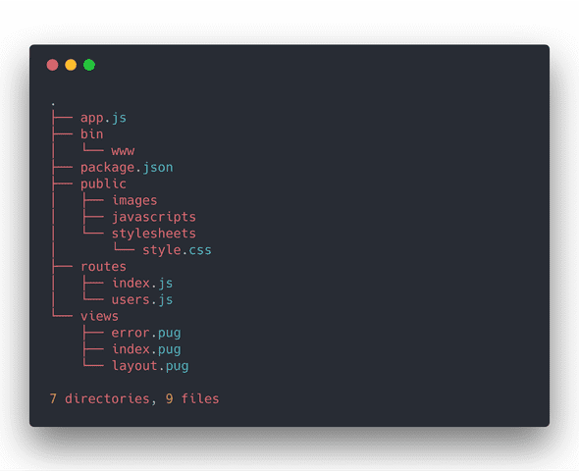
MVC in real-world?
Kiến trúc mặc định sử dụng Express Fw
Controller → routes
Views, Models?

Slide 6
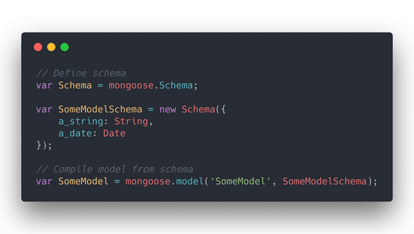
MVC in real-world?
Express is usually paired with MongoDB, a NoSQL which utilizes Mongoose ODM
Mongoose defines schemas to create models

Slide 7
References
https://expressjs.com/en/guide/database-integration.html
https://mongoosejs.com/docs/index.html
https://knexjs.org/

